Slide 1
Migrating to Microservices with Azure Service Fabric
Brian Swiger
Application Development Manager

Slide 2

Brian Swiger
App Dev Manager @ Microsoft
20+ years of development and architecture experience
Microsoft Certified Trainer (MCT) & Solutions Developer
Azure Certified Developer/Architect
Microsoft Learning Experiences (LeX) contributor – Exam development
@CodeBeing
http://www.mightybs.com
http://aka.ms/brianswiger

Slide 3
“Loosely coupled service oriented architecture with bounded contexts.”
Adrian Cockcroft
Netflix Cloud Architect / VP AWS

Slide 4
History of microservices at Microsoft
2003: “Windows Fabric” microservices platform project started
2007: Azure SQL DB service project starts with Windows Fabric
2009- many Azure and Microsoft services use Windows Fabric
2014: Decision to make Windows Fabric a public platform – renamed to Service Fabric
April 2015: Developer SDK preview released at //build
November 2015: Public preview of Azure Service Fabric
March 2016: GA of Azure Service Fabric on Windows
Sept 2016: Public preview of Azure Service Fabric for Linux

Slide 5




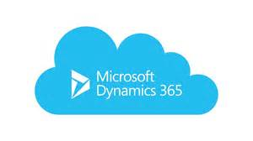

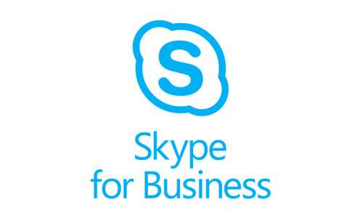

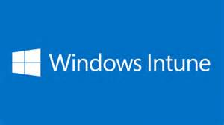
Services Powered by Service Fabric
Document DB
Billions transactions/day
IoT Hub
10 of Ks devices &
millions of messages
Event Hubs
20bn events/day
SQL Database
2.0 million DBs
Skype
Cortana
Intune
Dynamics
Power BI

Slide 6
Some Application Considerations
You do not own the hardware
Be prepared for failures
Scale is unpredictable. Can you scale efficiently?
Managing services is often harder than building services. Do you have the right operational telemetry for visibility?
No downtime upgrades
Are the costs understandable and controllable? Do you know the density and capacity of your services?
Care upfront about security
Developer productivity. Build the app not a platform.

Slide 7




Why a microservices approach?
Continually evolving applications
Faster delivery of features and capabilities to respond to customer expectations
Build and operate a service at scale
1
4
Plan
Monitor + Learn
Development
Production
2
3
Develop + Test
Release
Notes:
Read the following overviews
https://azure.microsoft.com/en-us/documentation/articles/service-fabric-overview-microservices/
MSDN Article on Service Fabric https://msdn.microsoft.com/en-us/magazine/mt595752
Watch this video https://channel9.msdn.com/Events/Visual-Studio/Connect-event-2015/911
Gartner Definition of Cloud-Native Applications
This use case includes applications at any scale, which have been written with the strengths and weaknesses of public cloud IaaS in mind. Cloud-native applications assume that resilience must reside in the application and not in the infrastructure (low "compute resilience" weighting), that the application can run well in a variety of underlying infrastructure configurations (low "architecture flexibility" weighting), that the customer's IT organization will attend to security concerns (low "security and compliance" weighting), and that there are only minimal integrations with existing on-premises infrastructure and applications (low "enterprise integration" weighting). Automation, API capabilities and scale-out capabilities are, however, extremely important. Because many such applications have big data aspects, the big data enablement capability also receives a high weighting in this use case

Slide 8


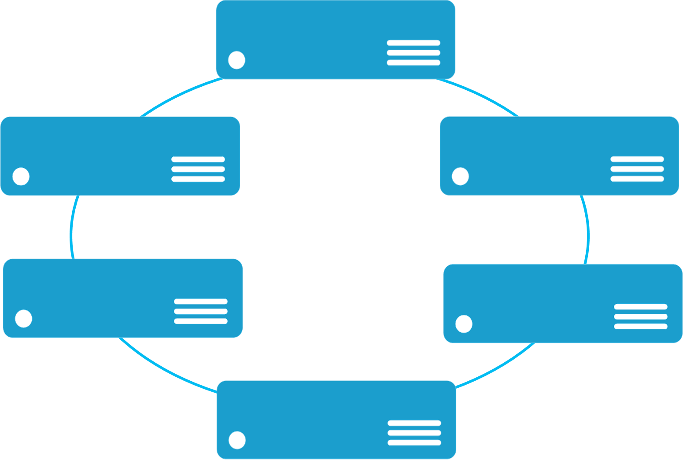


Monolithic application approach
Microservices application approach
A monolith app contains domain specific functionality and is normally divided by functional layers such as web, business and data
App 1
App 1
App 2
A microservice application separates functionality into separate smaller services.
Scales by cloning the app on multiple servers/VMs/Containers
Scales out by deploying each service independently creating instances of these services across servers/VMs/containers

Slide 9
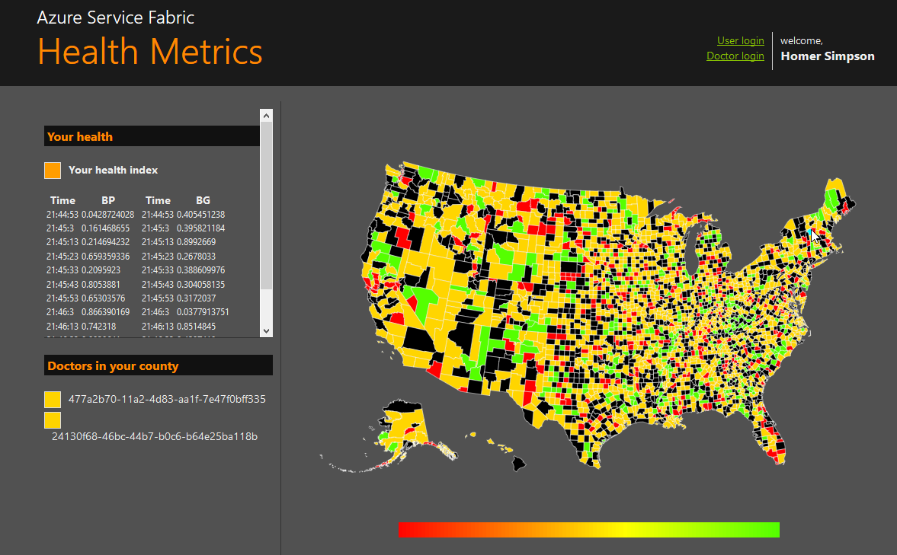
State in Monolithic approach
State in Microservices approach
Single monolithic database
Tiers of specific technologies
Graph of interconnected microservices
State typically scoped to the microservice
Variety of technologies used
stateless presentation services
stateless services
stateful services
stateless services with
separate stores

Slide 10
Microservices platform requirements
Build applications with multiple frameworks and languages
Microservices Platform
Deploy and manage applications to many environments

Slide 11

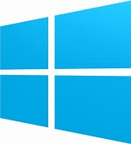

Azure Service Fabric
Lifecycle
Management
Always On Availability
Programming Models
Health & Monitoring
Dev & Ops Tooling
Auto
scaling
Orchestration
Dev Box
Azure
On Premise
Data centers
Other Clouds

Slide 12
Azure Service Fabric
Any OS, Any Cloud
Service Fabric Windows SDK
GAed
Service Fabric in Azure Stack GA
Coming Soon
Service Fabric on Linux in Azure
Preview
Service Fabric for Linux
Coming Soon
Service Fabric on Windows in Azure
GAed
Service Fabric on Linux in Azure
Preview
Service Fabric for Windows Server
GAed
Lifecycle
Management
Always On Availability
Programming Models
Health & Monitoring
Dev & Ops Tooling
Auto
scaling
Orchestration
Dev Box
Azure
On Premise
Data centers
Other Clouds

Slide 13

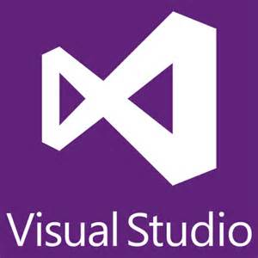

Azure Service Fabric microservices
Web Apps
ASP.NET Core
- OWIN
Reliable Actors
Guest Executables
(Any Code)
Visual
Studio
&
VSTS
Diagnostics & Monitoring
ELK
OMS
Splunk
AppInsights
Reliable Services
Containers
(Windows Containers & Docker)
Lifecycle
Management
Always On Availability
Programming Models
Health & Monitoring
Dev & Ops Tooling
Auto
scaling
Orchestration
Dev Box
Azure
On Premise
Data centers
Other Clouds

Slide 14


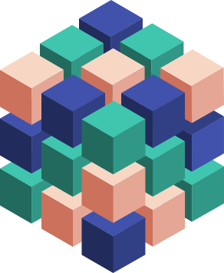
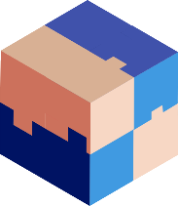



Migrating a traditional application to microservices
Traditional app
Hosted as guest executable or container in Service Fabric
With new microservices added alongisde
Breaking into microservices
Transformed into microservices
…You can stop at any stage

Slide 15

Service Fabric Cluster
Cluster supports 1,000s of nodes
is self repairing, and scales-in and out
Datacenter (Azure, On-Premises, Amazon)
PC/VM #2
Service Fabric
Your code, etc.
PC/VM #3
Service Fabric
Your code, etc. (Port: 19080)
PC/VM #1
Your code, etc.
Service Fabric
PC/VM #4
Load Balancer
Your code, etc.
Service Fabric
Your code, etc.
PC/VM #5
Web Request (Port: 80/443/?)
Service Fabric
Your code, etc.

Slide 16
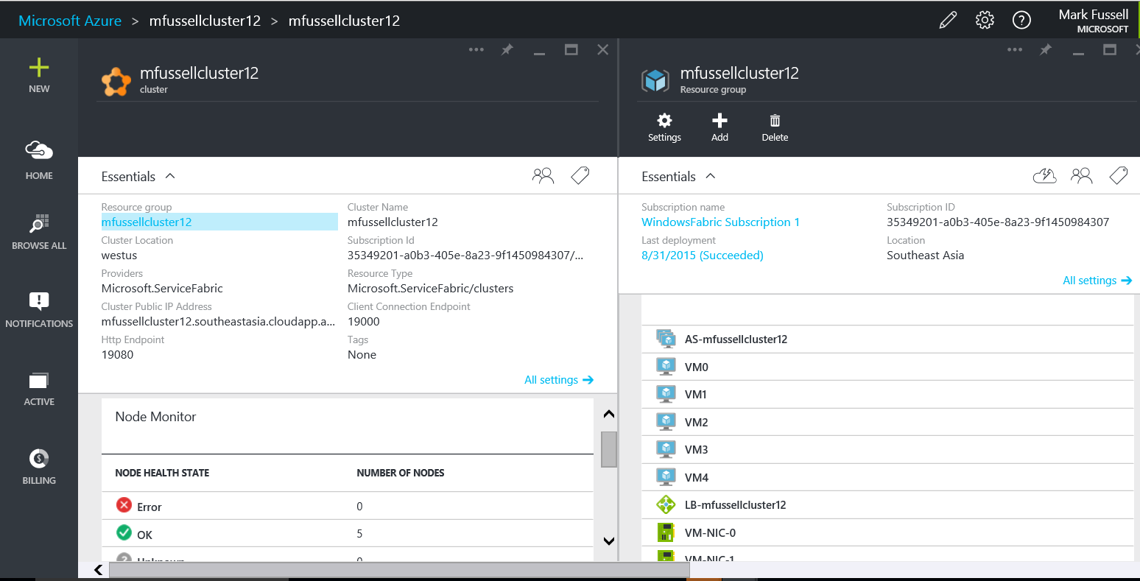
Demo: Service Fabric cluster via the portal
Notes:
For this demo read this doc link
https://azure.microsoft.com/en-us/documentation/articles/service-fabric-cluster-creation-via-portal/

Slide 17
Types of microservices from a Service Fabric perspective
Stateless microservice
Has either no state or it can be retrieved from an external store
There can be N instances
e.g. web frontends, protocol gateways, Azure Cloud Services etc.
Stateful microservice
Maintain hard, authoritative state
N consistent copies achieved through replication and local persistence
e.g. database, documents, workflow, user profile, shopping cart etc.
Notes:
Stateless services are identical to Worker roles in Cloud Services.
Stateful services are about bringing HA the programming model and democratizing HA for everyone. Service Fabric is a storage layer where the “hot” data that needs to be held close to compute is managed in statefull services.

Slide 18






Stateless Services Pattern
Load Balancer
Scale stateless services backed by partitioned storage
Increase reliability and ordering with queues
Reduce read latency with caches
Manage your own transactions for state consistency
More moving parts each managed differently
Front End
(Stateless
Web)
Stateless
Middle-tier
Compute
Cache
Queues Storage
Notes:
<build slide>

Slide 19

Stateful Services Pattern Simplify design, reduce latency
Load Balancer
Application state lives in the compute tier
Low Latency reads and writes
Partitions are first class at the service layer for scale-out
Built in transactions
Fewer moving parts
External stores for exhaust and offline analytics
Front End
(Stateless
Web)
Stateful
Middle-tier
Compute
Cold Data Stores
For Exhaust
(Optional)
Notes:
<build slide>
All first party services are stateful

Slide 20
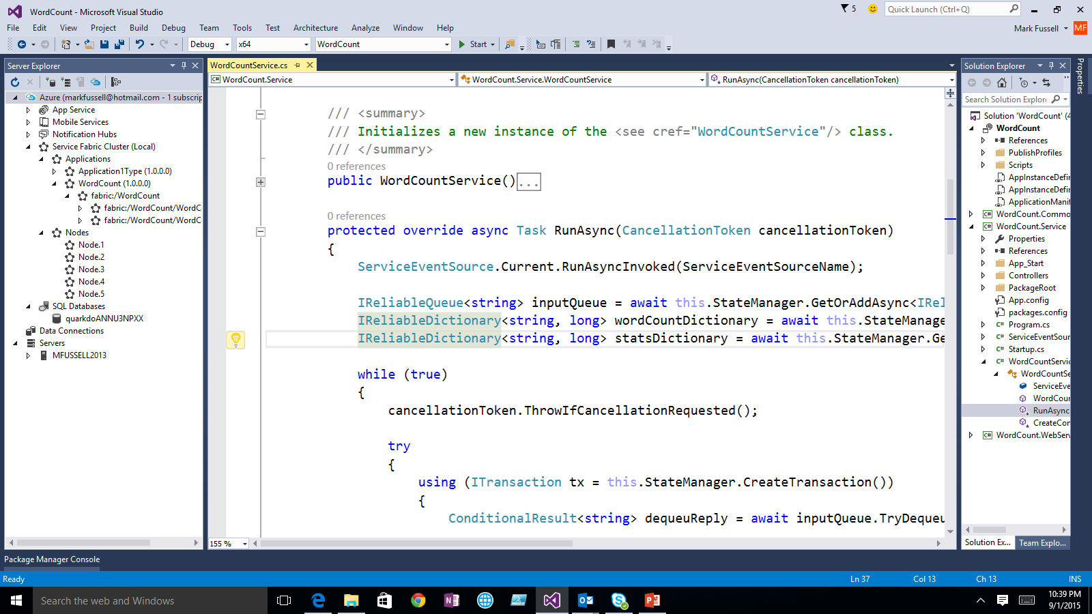
Demo: Building your first microservice with Service Fabric
Notes:
For this demo
1) Watch this - https://channel9.msdn.com/events/Visual-Studio/Connect-event-2015/912
And then this
2) https://channel9.msdn.com/events/Visual-Studio/Connect-event-2015/913

Slide 21
Building and managing microservice applications

Slide 22
Application type
Declarative template for creating an application
Based on a set of service types
Used for packaging, deployment, and versioning
Application Type A
Service Type 1
Service Type 2
Service Type 3
Code
Config
Data
Code
Config
Data
Code
Config
Data

Slide 23
Reliable Services API
Build stateless services using existing technologies such as ASP.NET, node.js, EXEs etc
Manage concurrency and granularity of state changes with transactions in stateful services
Communicate with services using the technology of your choice (e.g Web API, WCF, [web]sockets, etc)

Slide 24
Reliable Collections
Reliable collections make it easy to build stateful services.
An evolution of .NET collections for the cloud.
Collections
Single machine
Single threaded
Concurrent
Collections
Single machine
Multi threaded
Reliable Collections
Multi machine
Replicated (HA)
Persistence (durable)
Asynchronous
Transactional

Slide 25


Reliable Collections
IReliableDictionary<K,V>
IReliableQueue<T>
Data is replicated and durably stored on multiple replicas.
Atomically update one or more collections using transactions.
Supports LINQ.
Notes:
Data is replicated and durably stored on multiple replicas.
Atomically update one or more collections using transactions.
Reads are repeatable within the transaction.
Enumerations are snapshot based.
Supports LINQ.

Slide 26
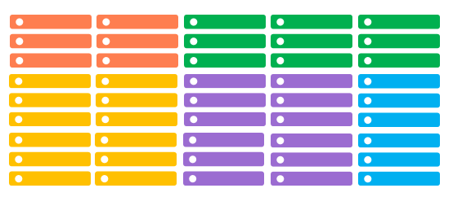
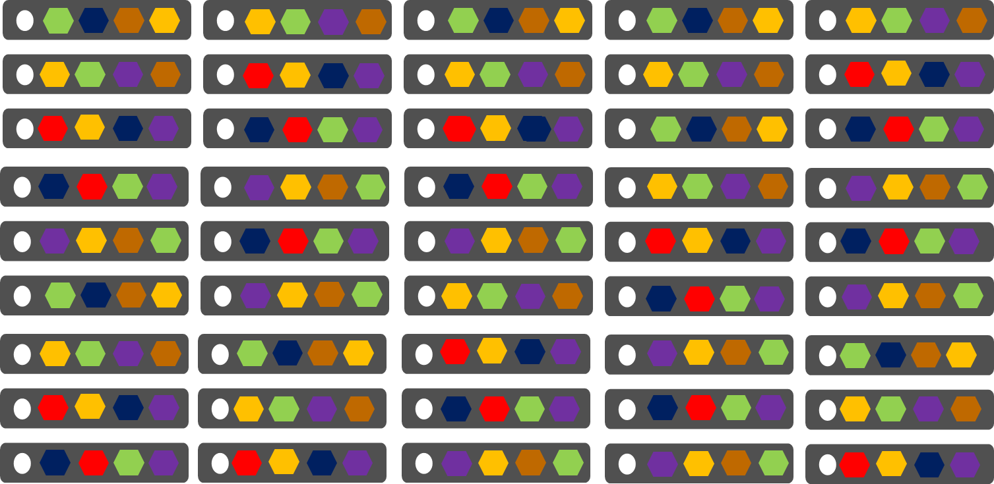
Comparing Azure Cloud Services vs. Azure Service Fabric
Azure Cloud Services
(Web and Worker Roles)
Azure Service Fabric
(Microservices)
1 service instance per VM with uneven workloads
Lower compute density
Slow in deployment & upgrades
Slower in scaling and disaster recovery
Many microservices per VM
High microservices density
Fast deployment & upgrades
Fast scaling microservices across the cluster

Slide 27
Cloud Service Application Design

Slide 28
Service Fabric Application Design

Slide 29




Comparing Azure Cloud Services vs. Azure Service Fabric
Cloud Services OR Service Fabric Stateless Service
Service Fabric Stateful Service
Azure Queue
Azure Tables/NoSQL

Slide 30
Service Fabric cluster with microservices
App1
App2
Notes:
There are two important concepts to understand with Service Fabric
First you create a pool of machines called a Service Fabric cluster. This can start as small as 3 machines and grow to thousands of machines. It is fully elastic, and with no single point of failure.
This cluster of physical or virtual machines can be heterogeneous, some small, some large as well. In Azure the clusters can be deployed across availability sets and across regions for redundancy. These are VMs that you own, joined by a VNET and stitched together to form a scalable cluster.
Second you build applications that are composed of discrete microservices by writing code. Then you simply tell Service Fabric through a declarative model to deploy these service across the cluster Service Fabric determines the best place to insatiate and run them, based on the available machine resources. You can create multiple copies of the same application instance and you can reuse microservice across difference applications.
This is application and service orchestration achieving unparalleled levels of density and control at the APPLICATION level. The services are placed into containers, processes today and Windows Containers when they are available for resource and security isolation. Note; this is not simply about moving containers around, this is understand how to manage the microservices within those containers which is actually the code you as a developer write.

Slide 31
Handling machine failures
App1
App2
Notes:
Importantly Service Fabric orchestration of the services is transparent to you in the event of failures.
For example if a machine fails then all the services that were running on that machine are automatically redistuted acorss the cluster, based on the available machine resources as well as understanding the resource usage of the microservices. This is critical for example for running SQL Azure DBs where you have some very large databases and many smaller ones. Getting the best package density enables you to run the service efficiently at scale, something no human could realistically achieve.

Slide 32
What is an Actor?
An independent unit of compute and state with large number of them executing in parallel
Communicates with other actors using asynchronous messaging
Has single threaded execution (turn based concurrency)
Notes:
The Actor concept was originated in the early 70 in order to do large scale parallel processing and is becoming more popular with the advent of cloud computing. It’s meant to make writing distributed applications easier by dividing the problem in multiple units of state and computation that can run in parallel. Each unit in a simple single-threaded. Actors are actually very similar to objects in the way they represent state with some logic that operates on that state. These actors communicates with each other using asynchronous messages.
Running the actors on top of Service Fabric, you get the reliability of code as well as state and all other benefits of Service Fabric platform, like security, placement and resource balancing, zero downtime upgrade, locally replicated stores.

Slide 33
Create a Reliable Actor
Define Actor Interface
public interface IHelloWorld : IActor {
... }
Implement Actor Interface
public class HelloWorldActor : Actor, IHelloWorld {
... }
Register Actor Implementation with Runtime
using (var fabricRuntime = FabricRuntime.Create())
{
fabricRuntime.RegisterActor(typeof(HelloWorldActor));

Slide 34
Service Fabric is a Container Orchestrator
Service Fabric performs the placement and failover of containers in the cluster
Deploy Docker containers on Linux
Deploy Windows containers on Windows (which communicate via the Docker Agent)
Containers can be deployed with
Code with guest executables or Service Fabric programming models
Endpoints in a container can be registered with Service Fabric for discoverability

Slide 35
Containers
Quotas and limits
Added Isolation
Linux
Process
Linux container
Virtual Machines
(Xen, KVM)
Kernel
Windows
Process
Windows Server Containers
Hyper-V Containers
Hyper-V Virtual Machines
Kernel
Faster and more efficient More isolated and more secure

Slide 36
Processes
Maximum speed and density
Containers on Windows
PROCESS
PROCESS
PROCESS
Traditional virtual machines = hardware virtualization
Application
VM
VM
VM
Kernel
OS
Windows Server Containers
Speed and density
Hardware
CONTAINER
CONTAINER
CONTAINER
Processes = an executing program
Containers = Operating system virtualization
Kernel
OS
Hyper-V Containers
Isolation plus performance
CONTAINER
CONTAINER
PROCESS
PROCESS
Applications
CONTAINER
CONTAINER
CONTAINER
Kernel
Hardware
Kernel
Kernel
Kernel
Hyper-V

Slide 37
Service Fabric Container Integration - Guest Container
Container Images
Datacenter (Azure, On-Premises)
<ServiceManifest Name=“ContosoServiceTypePkg" Version="1.0">
<ServiceTypes>
<StatelessServiceType ServiceTypeName=“ContosoServiceType" ... >
</StatelessServiceType>
</ServiceTypes>
<CodePackage Name="CodePkg" Version="1.0">
<EntryPoint>
<ContainerHost> <ImageName>contoso/frontend</ImageName> </ContainerHost>
</EntryPoint>
</CodePackage>
. . .
</ServiceManifest>
FE
VM #1
FE
Side car
image: contoso/frontend
Order Service
Service Fabric
image: contoso/order
VM #5
VM #2
Data
base
Side car
FE
Side car
Side car
image: contoso/config
Service Fabric
Service Fabric
Data
base
VM #4
VM #3
image: contoso/data
Order Service
Side car
Database
Order Service
Side car
Service Fabric
Service Fabric

Slide 38
Service Fabric container capabilities
1) Container image deployment and activation.
2) Mapping of container ports to dynamic ports on host machine
3) Registration of container ports with the Naming Service for communicating between containers and distributed apps
4) Apply policy on containers for resource contraints. E.g. CPU, memory
5) Support for container private repository or trusted registry
6) Environment variables for Service Fabric runtime or providing input to the container app

Slide 39
Service Fabric management capabilities
Reliable optics into application health
Automatic repair action based on policies you set
Scales up/down based on service demand
Integrated alerting and notification system
Tools to effectively test a service for robustness
Tools for easy deployments and config management
Tools to perform service upgrades without downtime
Notes:
What are the management challenges for managing distributed applications at scale ?

Slide 40
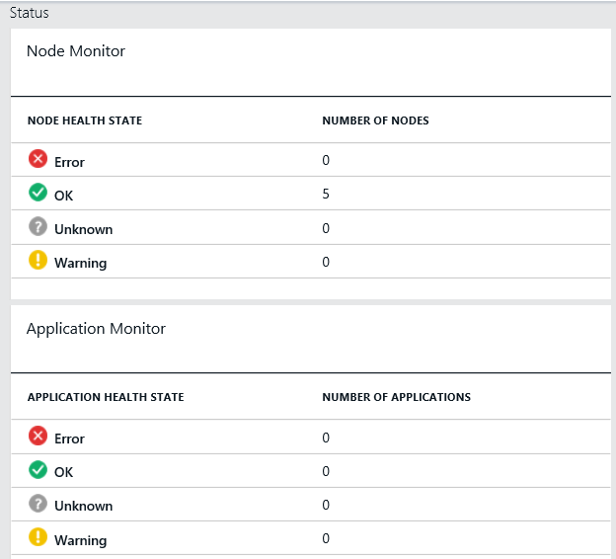
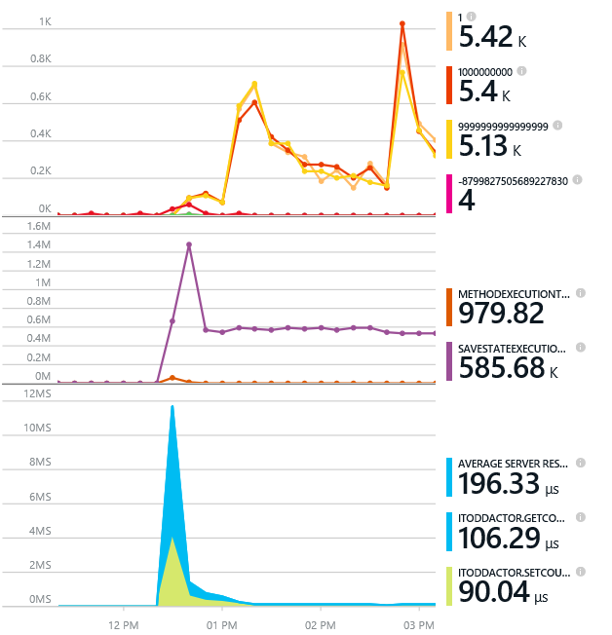
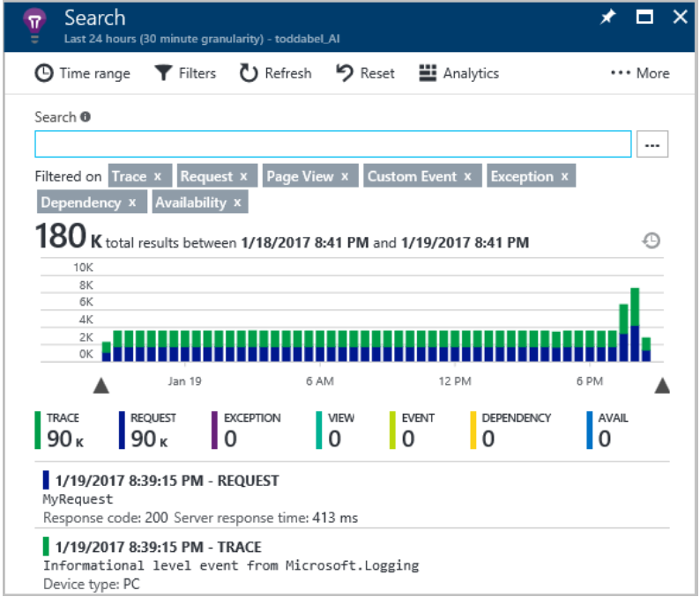
Monitoring your Services
Visibility into how your services are doing when running in production
Health status monitoring
Built-in health status for cluster and services
Flexible and extensible health store for custom app health reporting
Allows continuous monitoring for real-time alerting on problems in production
Performance and stress response
Rich built-in system events for Actors and Services programming models
Easy to add custom application performance metrics
System events can be viewed in OMS
Write application diagnostic event anywhere
Application events are captured with EventFlow
Can be pushed to any store for query e.g. AppInsights, ELK, Serilog

Slide 41
Application Upgrade
Upgrade Domain #1
Upgrade Domain #2
Upgrade Domain #3
App Repository
Windows OS
Windows OS
App A v1
Windows OS
App C v2
App A v1
App C v1
Fabric
Node
App B v2
Fabric
Node
Fabric
Node
App B v2
App C v2
App C v1
App C v1
App C v2
Windows OS
Windows OS
Windows OS
Fabric
Node
App B v2
App C v2
App B v2
App C v1
Fabric
Node
App A v1
App A v1
Fabric
Node

Slide 42
Next steps and resources
Service Fabric developer SDK
http://aka.ms/ServiceFabricSDK
Docs Learning map and overview videos
https://azure.microsoft.com/en-us/documentation/services/service-fabric/
Service Fabric course and lab parts 1 and 2
https://mva.microsoft.com/en-US/training-courses/building-microservices-applications-on-azure-service-fabric-16747
Learn from samples, free clusters and labs
http://aka.ms/ServiceFabricSamples
http://aka.ms/tryservicefabric
https://blogs.msdn.microsoft.com/azureservicefabric/2016/07/06/introduction-to-service-fabric-lab-part-1/
Questions? Comments? Issues?
https://stackoverflow.com/questions/tagged/azure-service-fabric
http://aka.ms/ServiceFabricForum
https://github.com/azure/service-fabric-issues

Slide 43
Thank you!
Brian Swiger
Application Development Manager

